Slide 1
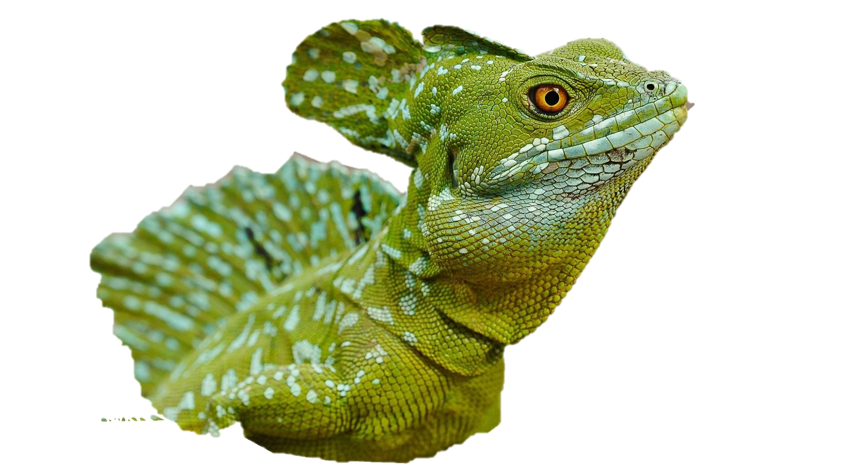
Basilisk lizard’s
locomotion

Slide 2
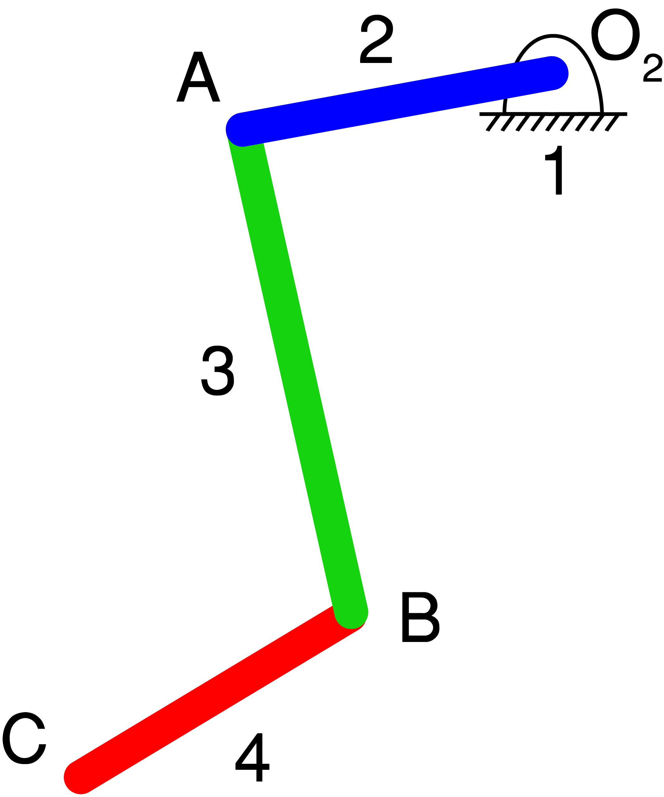
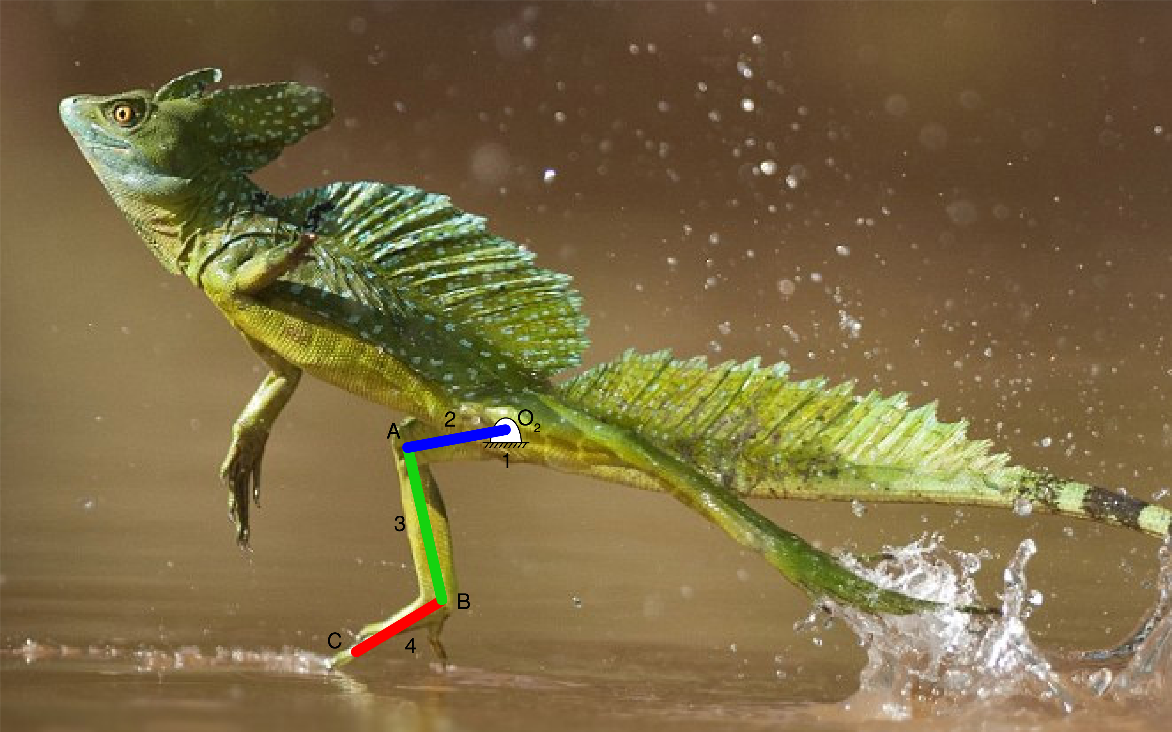
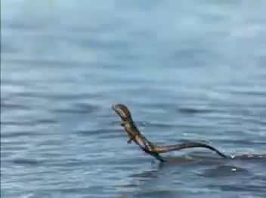
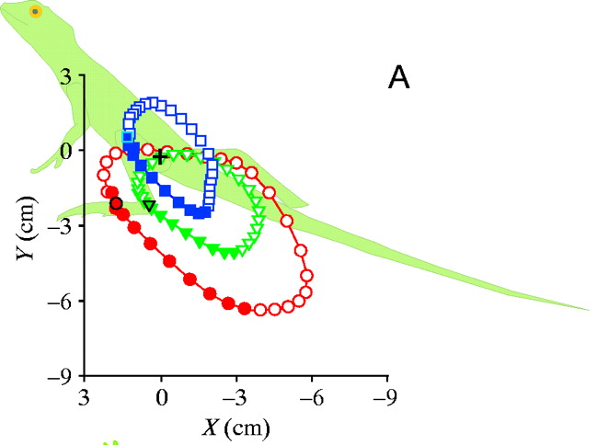
Part 1 :
Introduction and Data preparation
Kinematic diagram
The real Basilisk lizard runs on water.
Position of knee, angle and foot in xy plane
(http://jeb.biologists.org/content/206/23/4363

Slide 3
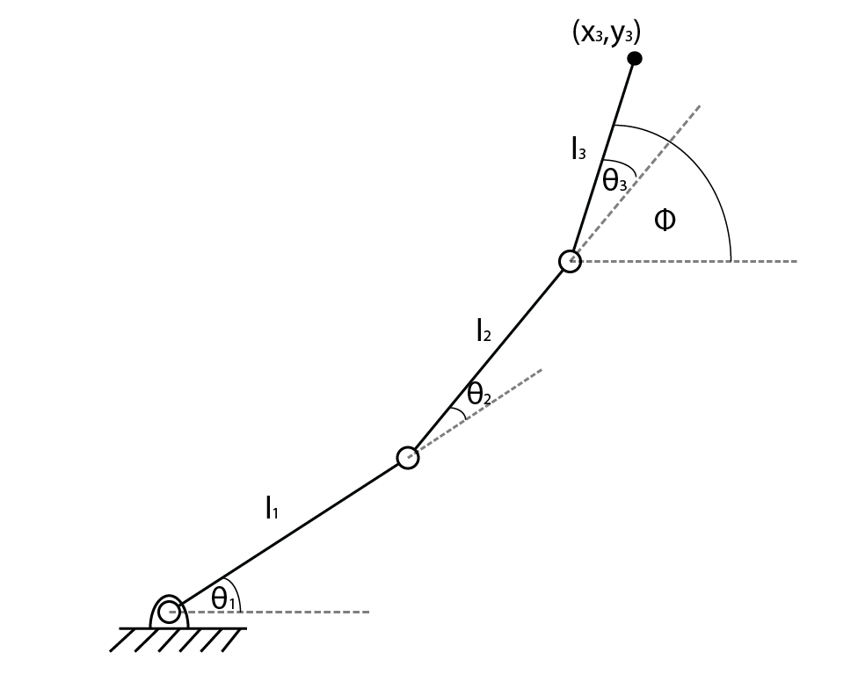
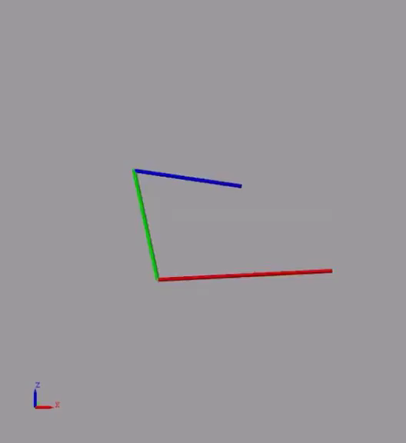
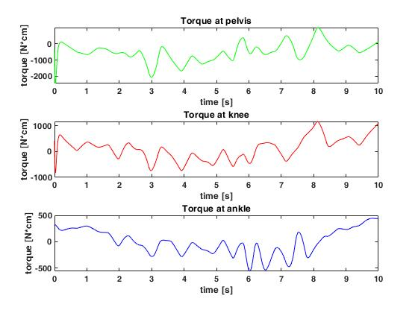
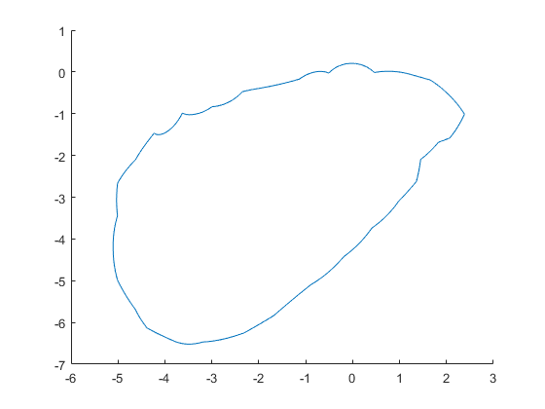
Part 2 :
1st Simscape run for reference
Inverse kinematics for theta calculation
Simulation
Sensing torque
Trajectory

Slide 4
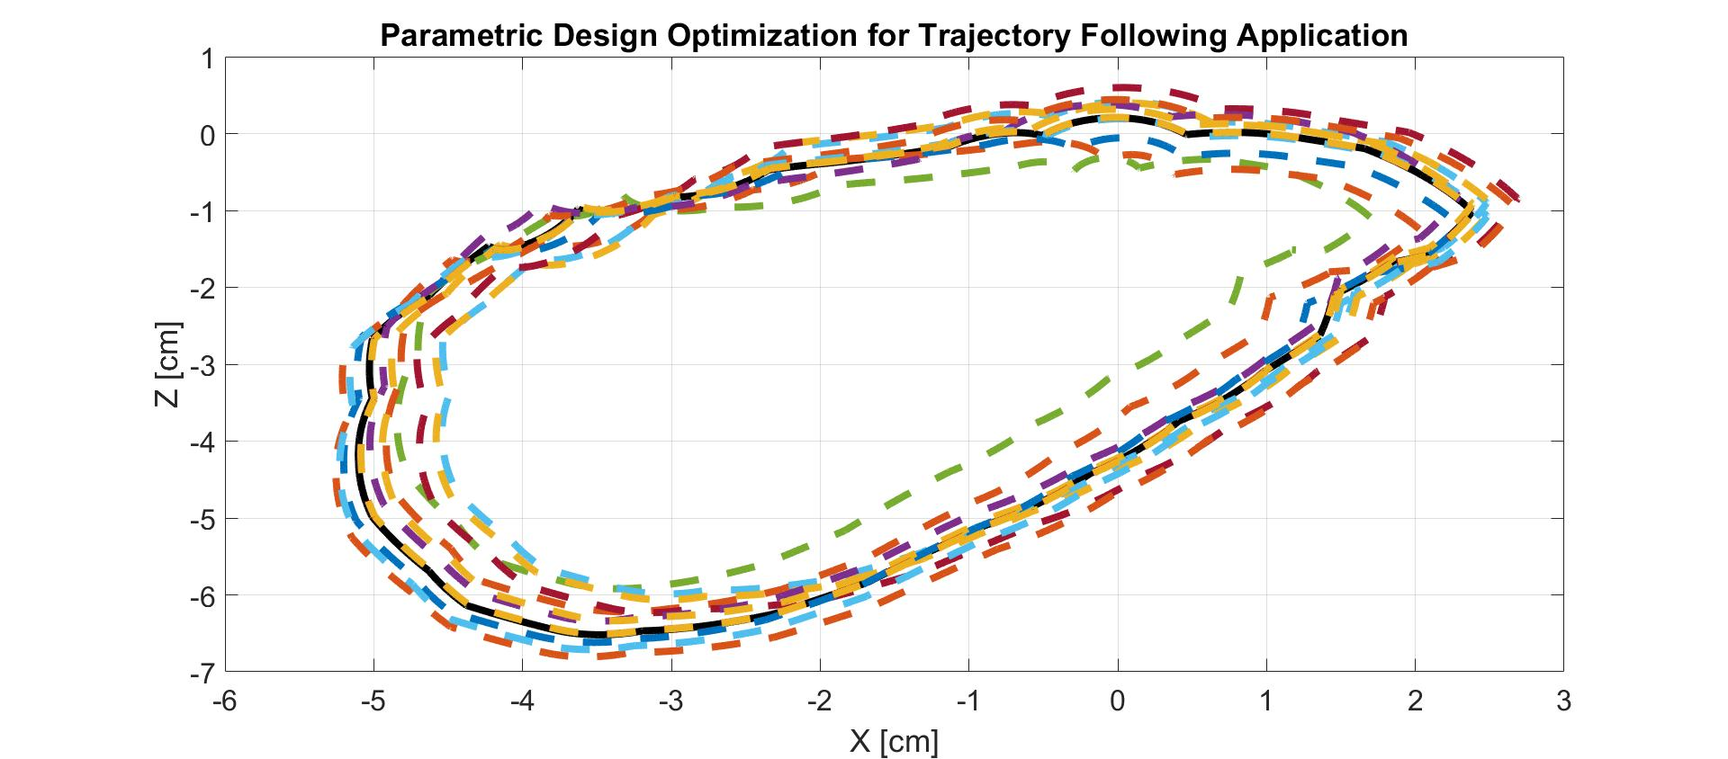
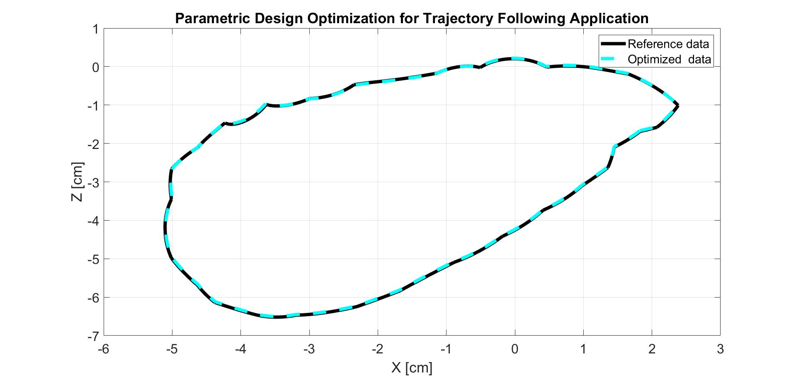
Part 3 :
2nd Simscape run for optimization
L1 : 2.1803 cm (2.1958 cm)
L2 : 2.2802 cm (2.2597 cm)
L3 : 3.5226 cm (3.5293 cm)

Slide 5
summary
OPTIMIZATION OUTPUT
PROBLEMS
L1 : 2.1803 cm
(2.1958 cm)
Error : 0.706%
3D LOCOMOTION
L2 : 2.2802 cm
(2.2597 cm)
Error : 3.514%
COMPLEX NUMBERS( THETA )
FROM INVERSE KINEMATICS
TORQUE SPIKE
L3 : 3.5226 cm
(3.5293 cm)
Error : 0.190%

